Slide 1

THE INSCRIBED LAYER
CHAPTER 04
‹#›

Slide 2
Topics
The Inscribed Layer
Inscribed Mechanics
Inscribed Aesthetics
Inscribed Narrative
Traditional Dramatics
Inscribed Technology
‹#›

Slide 3
The Inscribed Layer
All elements that are directly designed and encoded by game developers
Agency and Control
Completely within the hands of the developers
The game at rest
However, a game isn't a game unless someone is playing it
Which leads to the Dynamic Layer in the next chapter
Inscribed elements are encoded experiences
The designers think of an experience
They encode this experience into the Inscribed Layer
Players decode the experience into the Dynamic Layer
‹#›

Slide 4
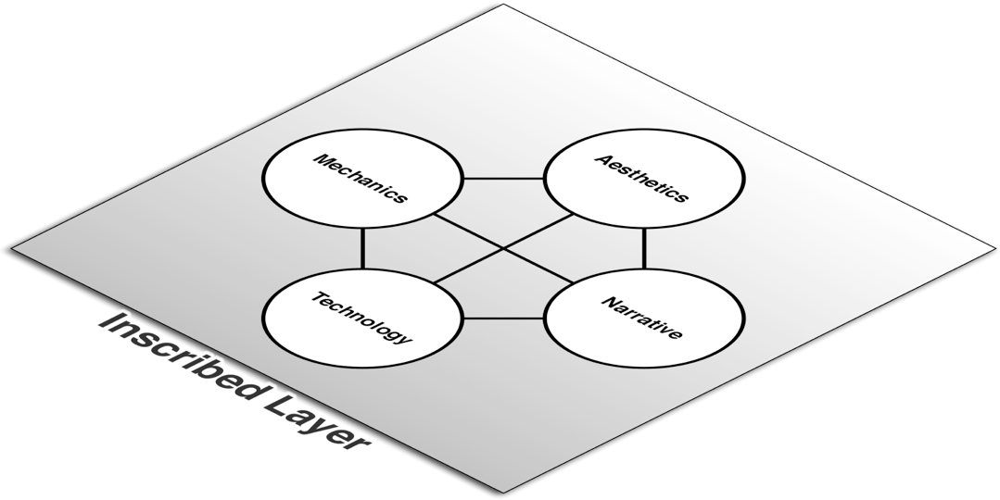
The Inscribed Layer
‹#›

Slide 5
The Inscribed Layer
Mechanics
Systems that define how the player and game will interact
Includes: Player interaction pattern, Objective, Rules, Resources, Boundaries
Aesthetics
How the game looks, sounds, smells, tastes, and feels
Technology
Paper and digital technology that enable gameplay
Narrative
Authored premise, characters, and plot
‹#›

Slide 6
Inscribed Mechanics
The job of a "game designer"
Board Games
Board layout
Rules
Cards / Dice / Other Randomizers
Seven Inscribed Mechanics
Objectives
Player Relationships
Rules
Boundaries
Resources
Spaces
Tables
‹#›

Slide 7
Inscribed Mechanics
The job of a "game designer"
Board Games
Board layout
Rules
Cards / Dice / Other Randomizers
Seven Inscribed Mechanics
Objectives
Player Relationships
Rules
Boundaries
Resources
Spaces
Tables
The job of a "game designer"
Board Games
Board layout
Rules
Cards / Dice / Other Randomizers
Seven Inscribed Mechanics
Objectives – What are the player's goals?
Player Relationships – How do players compete & collaborate?
Rules – What can and can't players do to achieve their goals?
Boundaries – Where are the edges of the game?
Resources – What holds value in the game?
Spaces – Where does the game take place?
Tables – What is the statistical shape of the game?
‹#›

Slide 8
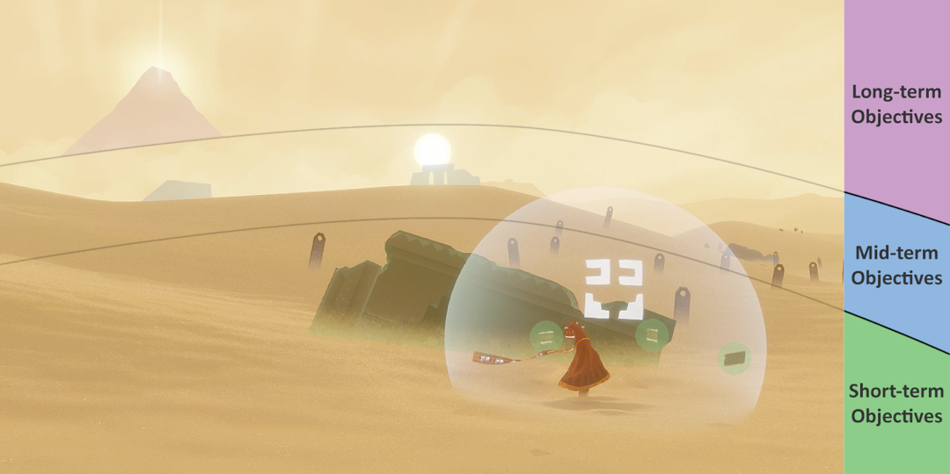
Inscribed Mechanics: Objectives
More than just the final objective of the game
Players are constantly weighing several possible objectives
Objectives are categorized by:
Immediacy
Short-, Mid-, and Long-term Goals
‹#›

Slide 9
Inscribed Mechanics: Objectives
More than just the final objective of the game
Players are constantly weighing several possible objectives
Objectives are categorized by:
Immediacy
Short-, Mid-, and Long-term Goals
Importance to the player
The player will not always care about the same things as the player character
According to Steam, Skyrim has been one of their most played games for over two years, but only 32.2% of players have finished the main storyline. ¹ ²
Objectives often conflict with each other
An element of "interesting decisions"
‹#›

Slide 10
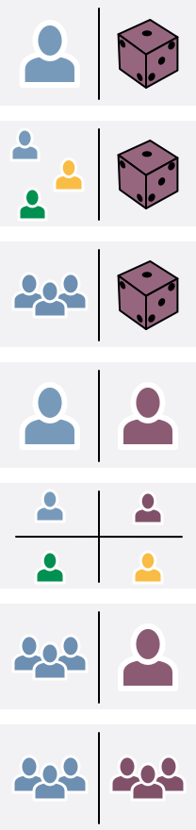
Inscribed Mechanics: Player Relationships
In Game Design Workshop, Fullerton lists seven player interaction patterns
Single Player vs. Game
Multiple Individual Players vs. Game
Cooperative Play
Player vs. Player
Multilateral Competition
Unilateral Competition
Team Competition
‹#›

Slide 11
Inscribed Mechanics: Player Relationships
Player relationships and roles are defined by objectives
Each player has several conflicting, layered objectives
Player roles in the game include
Protagonist: Player attempting to conquer the game
Competitor: Player trying to conquer other players
Collaborator: Player working with other players
Citizen: Player in the same game as other players but not working with or against them
Each player in a multilateral game can play all of these roles at different times relative to other players.
‹#›

Slide 12
Inscribed Mechanics: Rules
Rules limit players' actions
In paper games, rules are the designer's most direct inscription of her vision of the game
In digital games, the programming code can be seen as the inscription of the rules of the game
Rules can be explicit or implicit
Explicit: Roll the die and advance the number of spaces shown
Implicit: Don't lie about the number shown on the die
‹#›

Slide 13
Inscribed Mechanics: Boundaries
Define the edges of the space and time in which the game takes place
Within the boundaries, game resources have value, and the rules must be followed
Boundaries are the edge of the "Magic Circle"
Alternative Reality Games (ARGs) work by perforating the boundary of the magic circle.
‹#›

Slide 14
Inscribed Mechanics: Resources
Things that have value in the game
Two types:
Assets: Actual objects in the game
Link's equipment in The Legend of Zelda
Houses, hotels, and property in Monopoly
Attributes: Numbers representing value in the game
Health
Amount of air left when swimming under water
Experience
‹#›

Slide 15
Inscribed Mechanics: Spaces
Navigable spaces in the game
Both the board in board games and levels in digital games
Things to consider when designing spaces:
The purpose of the space
Why does it exist?
Why is it important to the player?
Flow of movement
Can the player move through the space easily?
Landmarks
Does the player have landmarks to help her orient herself?
Experiences
Does the space offer the player interesting experiences?
Objectives
Does the space contain short-, medium-, and long-term objectives?
‹#›

Slide 16
Inscribed Mechanics: Tables
Tables are grids of game information
Used extensively for game balance
Tables have several purposes, including:
Probability
Tables can determine probability in very specific circumstances
A table could show the relative offensive and defensive strength of two armies based on the terrain that they inhabit (e.g., Advanced Wars)
Progression
Tables often hold information about how players abilities increase and change as their player level increases (e.g., Dungeons and Dragons)
Playtest Data
Tables are used extensively in game testing to record information about the game test and the player's reaction to the game
‹#›

Slide 17
Inscribed Aesthetics
Aesthetics are the elements perceived by the player's five senses
Inscribed Aesthetics are those created and inscribed by the developers of the game
These include
Visual Art
Sound and Music
Tactile Elements
Scented Elements
Taste(?)
‹#›

Slide 18
Inscribed Aesthetics: Vision
Game developers put a tremendous amount of effort into their visual aesthetic
Game graphics have improved tremendously over the last 25 years
Not just character models and texturing
Also includes
Box art
Advertising
Font choice
Game website
All of these must have a consistent visual aesthetic
‹#›

Slide 19
Inscribed Aesthetics: Hearing
Audio quality has also improved tremendously over the last 25 years
Various platforms have different audio capabilities
Console and PC audio is very, very high quality
Mobile game audio is often never heard
Background noise vs. Small speaker size
Owners often mute mobile devices
Various types of audio are good for different things:
Audio Type Immediacy Best For
Sound Effects Immediate Alerting the player Conveying simple information
Music Medium Setting the mood
Dialogue Medium / long Conveying complex information
‹#›

Slide 20
Inscribed Aesthetics: Touch
Paper Games
The tactile sensation of holding game pieces
Do they feel high-quality or cheap?
Will they last over time or fall apart?
3D printing offers new, exciting possibilities for paper game pieces
Digital Games
The tactile sensation of using the game controller
Many adults have difficulty playing a Nintendo DS for extended periods of time
The motions required to play games can also cause player stress (e.g., "controller thumb")
Controller rumble feedback is a designed, inscribed touch sensation
‹#›

Slide 21
Inscribed Narrative
The dramatic elements of a game that have been designed and inscribed by the game developers
Four Components
Premise: The world in which the story takes place
The story's narrative basis
Example: "A long time ago in a galaxy far, far away"
Setting: The details of the space in which the story takes place
Example: A moisture farm on the desert planet, Tatooine.
Character: The people featured in the story
All stories are about people, and the best are about people whom we care about and who are affected and changed by the story
Plot: The sequence of events that take place in the story
Character + Objective + Obstacles = Drama
Based in traditional dramatics
‹#›

Slide 22
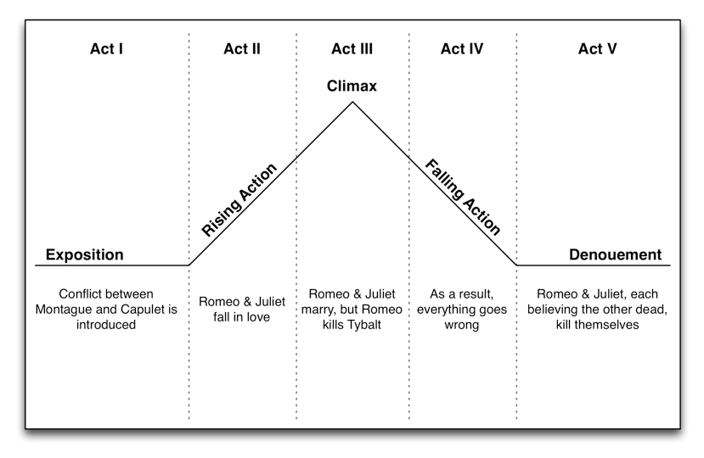
Traditional Dramatics
Dramatics have been studied for thousands of years
Gustav Freytag's Five-Act Structure
‹#›

Slide 23
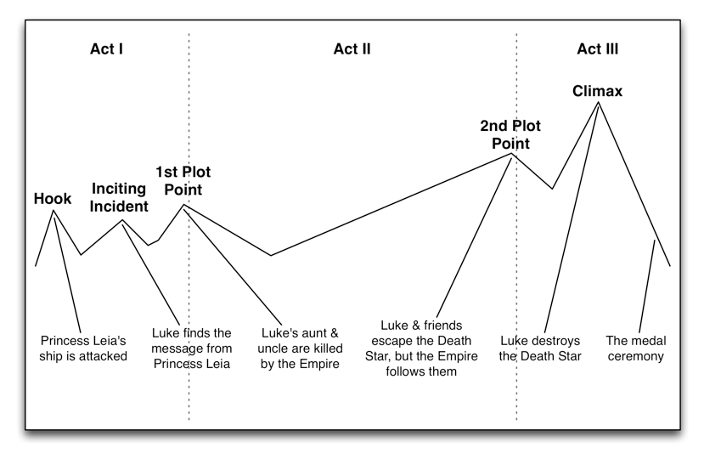
Traditional Dramatics
Syd Field's Three-Act Structure
‹#›

Slide 24
Inscribed Narrative
Differences between interactive and linear narratives
Plot vs. Free Will
Linear narrative relies on a prescribed plot
Interactive narrative can allow the player free will
But free will can be expensive and difficult to accommodate
Methods of allowing limited free will in games
Limited possibilities - The player is presented with only a few possibilities to choose from, granting some choice
Optional linear side quests - This gives the player the option to choose which of the side quests she wants to experience while still giving her a single, linear main quest. Some side quests can be mutually-exclusive, giving weight to the choice of side quest.
Foreshadow multiple possibilities - Foreshadowing works in linear narrative because the author knows what will happen. In interactive narrative, many things can be foreshadowed subtly, and hopefully only those that actually happen will be noticed by the player.
Develop minor NPCs into major ones - If the player fights a number of minor NPCs, let the last one get away and turn into a nemesis for the player. This is most often used in pen and paper roleplaying games.
‹#›

Slide 25
Inscribed Narrative
Differences between interactive and linear narratives
Empathetic Character vs. Avatar
In linear narratives, the viewer/reader is expected to empathize with the main character
In interactive narrative, the player is the main character, to some extent
In a game like Tomb Raider or Halo, the main character has her own personality that the player takes on like a role.
In a game like World of Warcraft or Skyrim, the player can choose the kind of character that she wants to be, and the game will respect her decision
The in-game character is an avatar of the player
‹#›

Slide 26
Inscribed Narrative
Purposes for Inscribed Dramatics
Evoking Emotion
Writers have learned over centuries how to evoke emotion through narrative
Motivation and Justification
Game narrative can give the player a goal and justify her actions in the game
Progression and Reward
Game narrative can act as a measure of progress in the game
The progress of the linear game narrative can help a player understand her amount of progress through the game
Players are often rewarded by a cutscene at the end of a level
Mechanics Reinforcement
In board games in particular, narrative can help players remember the rules and understand them (e.g., Up the River )
‹#›

Slide 27
Inscribed Technology
The technology designed and inscribed by developers to enable play of the game
Paper inscribed technology includes:
Randomization
Dice, spinners, and cards
State Tracking
Score tracking, tables, and character sheets
Progression
The technological design of elements like leveling tables
The technology tree in Civilization was a technological advancement
Later used for character leveling choices in Diablo II
Digital inscribed technology is mostly programming code.
‹#›

Slide 28
Chapter 4 – Summary
The four elements of the Inscribed Layer encompass everything that the player receives when she purchases the game
The Inscribed Layer is the only layer which the developers have complete control over
When players begin to play a game, it moves into the Dynamic Layer
The topic of the next chapter
‹#›

